Slide 1
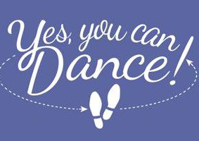
Dance Class for Multiple Sclerosis
Sponsored by Yes You Can Dance
In Partnership With
The University of Pittsburgh and the
Pennsylvania Keystone Chapter MS Society

Slide 2
Yes You Can Dance
Non-profit organization dedicated to transforming lives through the power of dance
We say “yes you can dance” to people who don’t think they can
Work with special needs and elderly populations and now people with MS

Slide 3
MS Dance Class
8 week session, 1 hour per week
Professional dance instructor
Participants paired with trained dance mentors
Criteria for participation
Diagnosis of Relapsing-Remitting MS
Able to walk on level ground without an assistive device but may use a cane when necessary

Slide 4
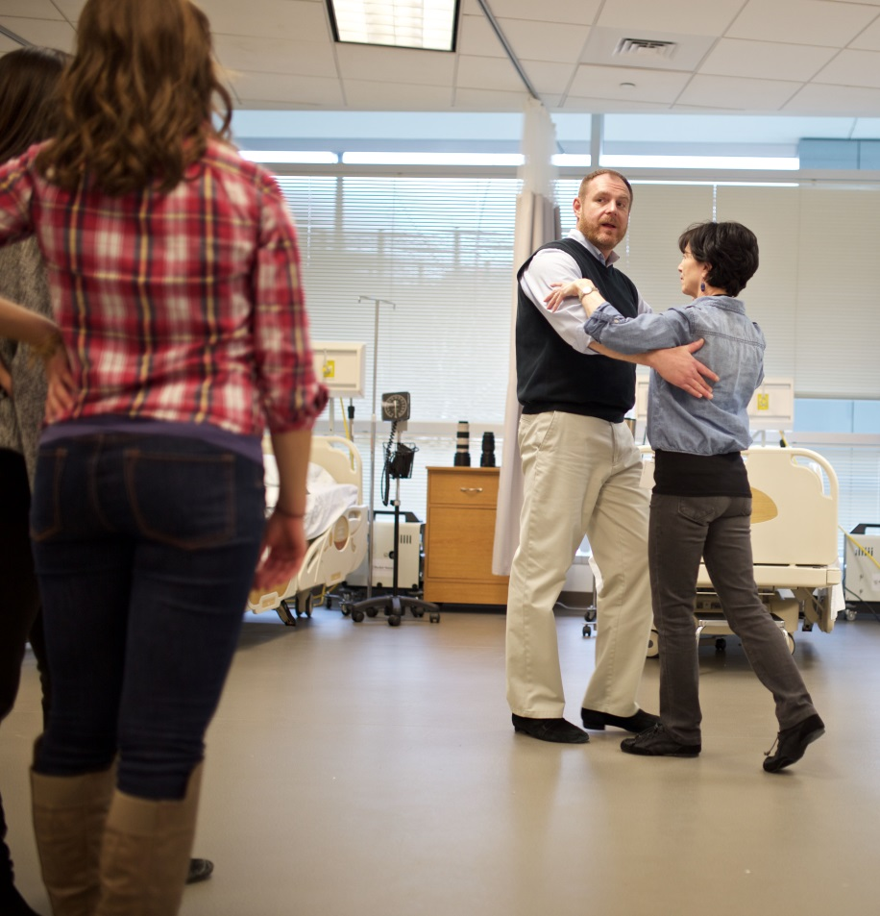
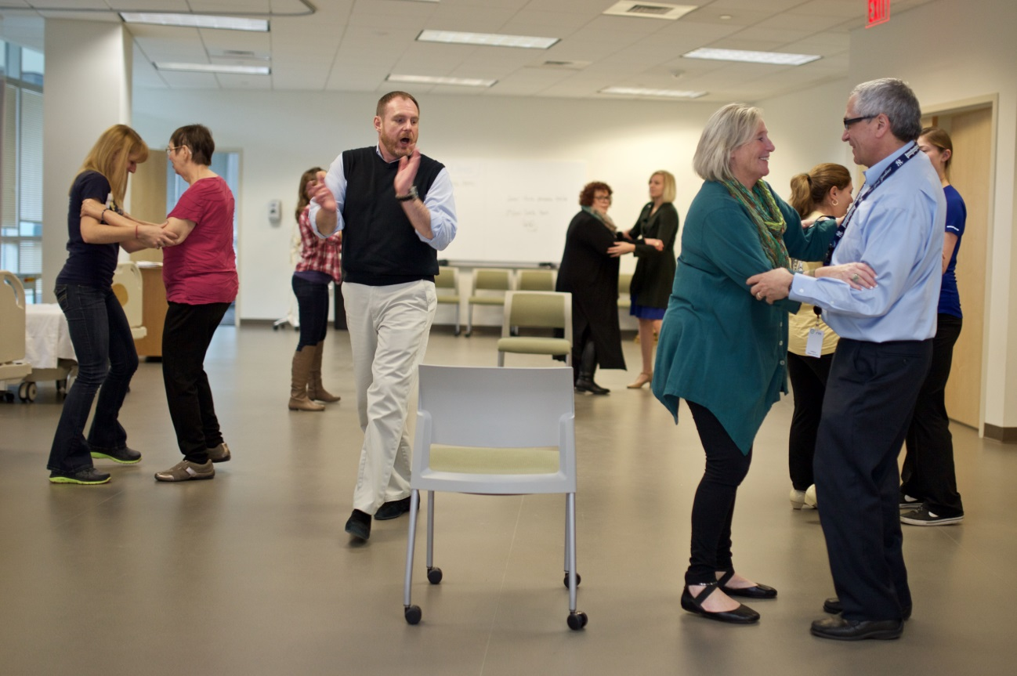
Instructor demonstrates
Everybody practices

Slide 5
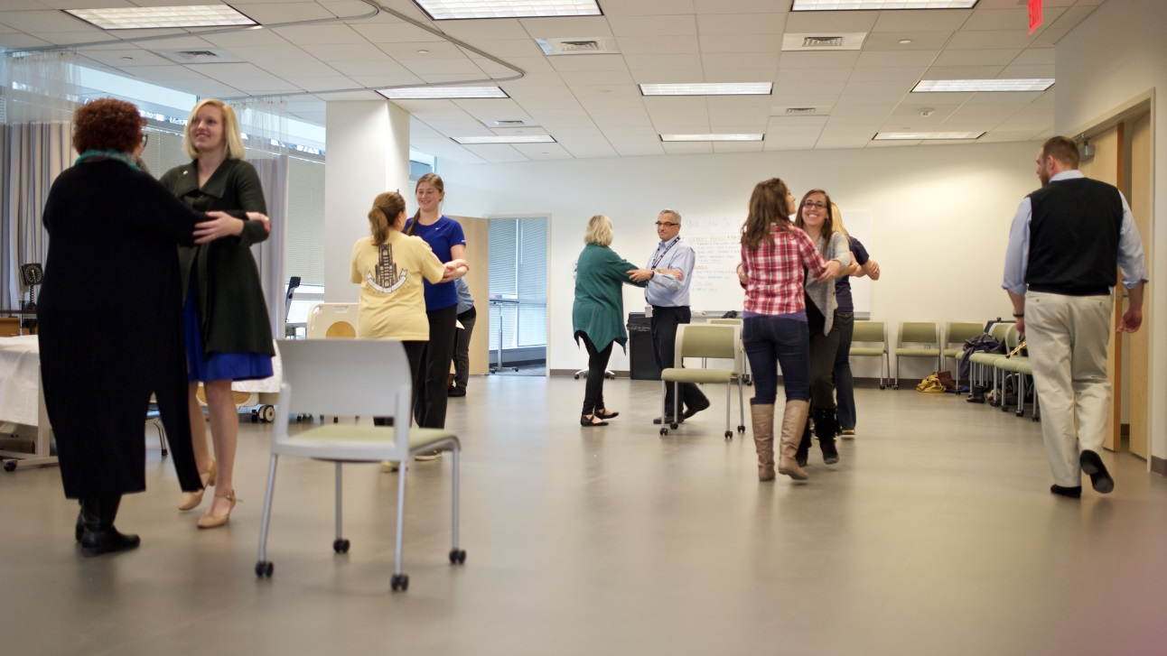
What’s Covered
Elements of Dance
Forward Step
Backward Step
Side Step
Rock Step
Walk Around Turn
Dances
Rumba
Salsa
Swing
Tango

Slide 6
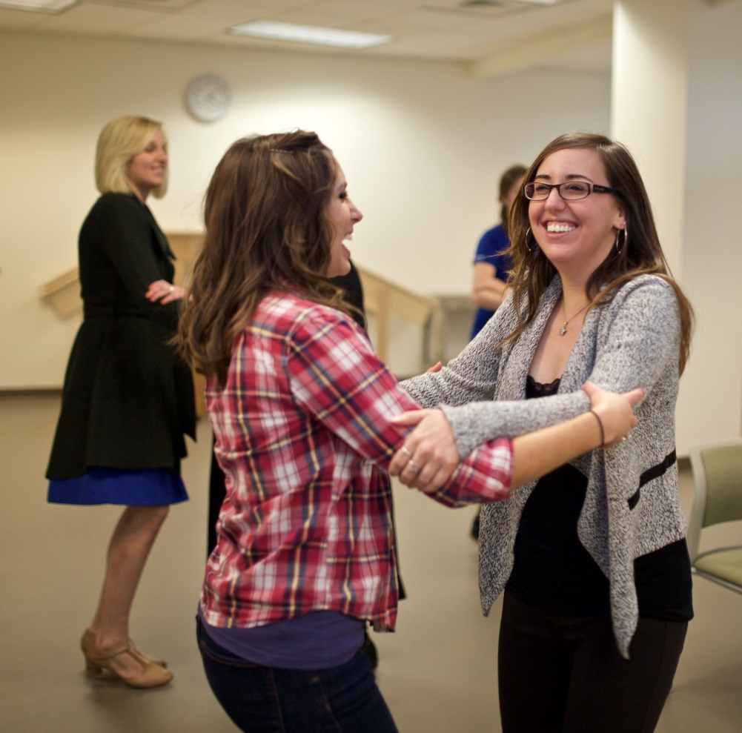
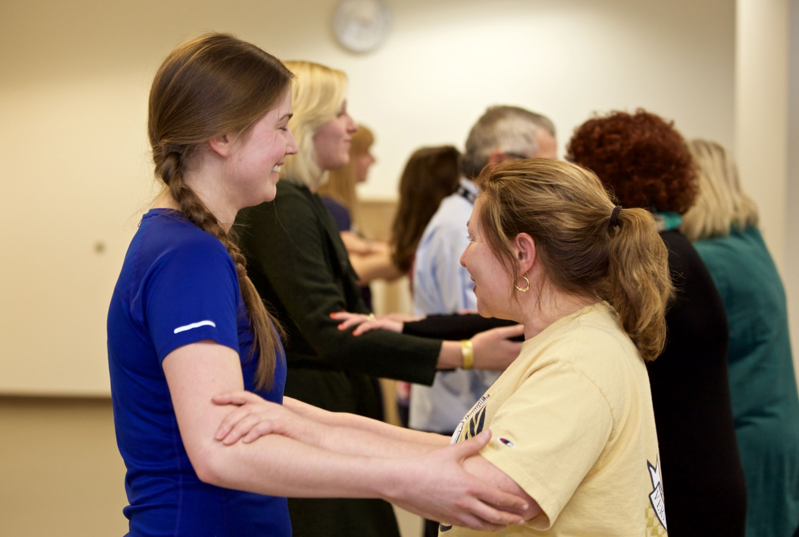
Dancing makes you smile

Slide 7
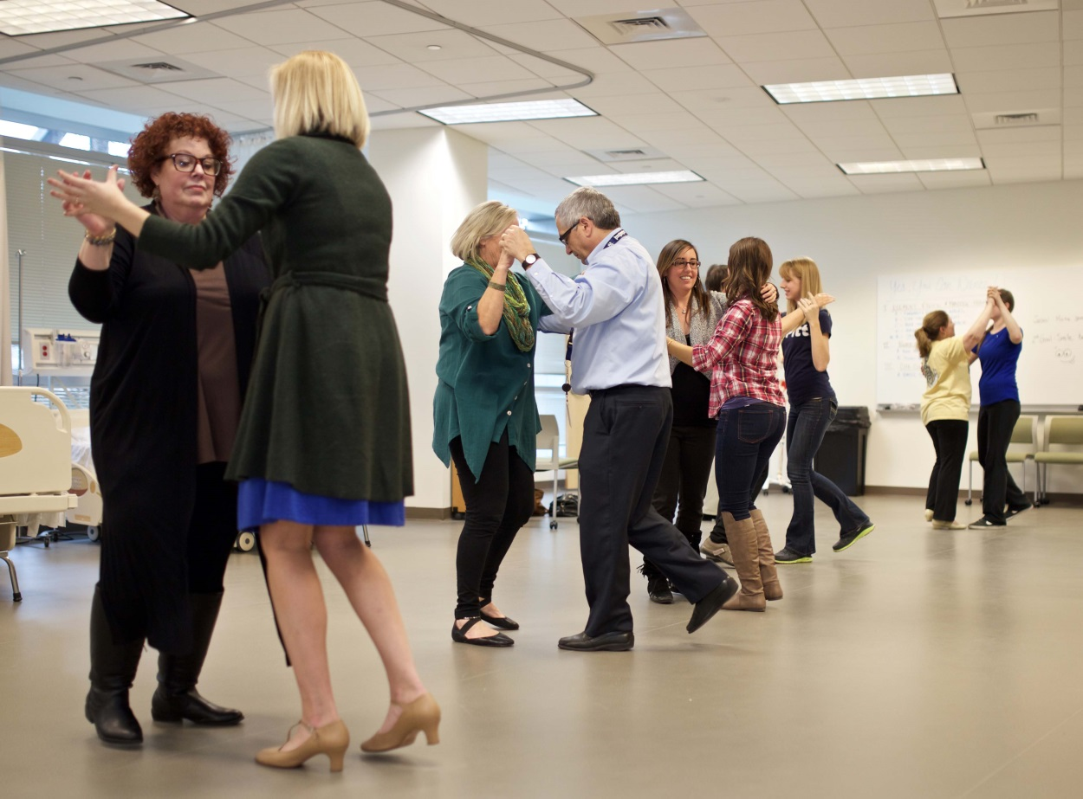
And forget about your troubles for awhile

Slide 8
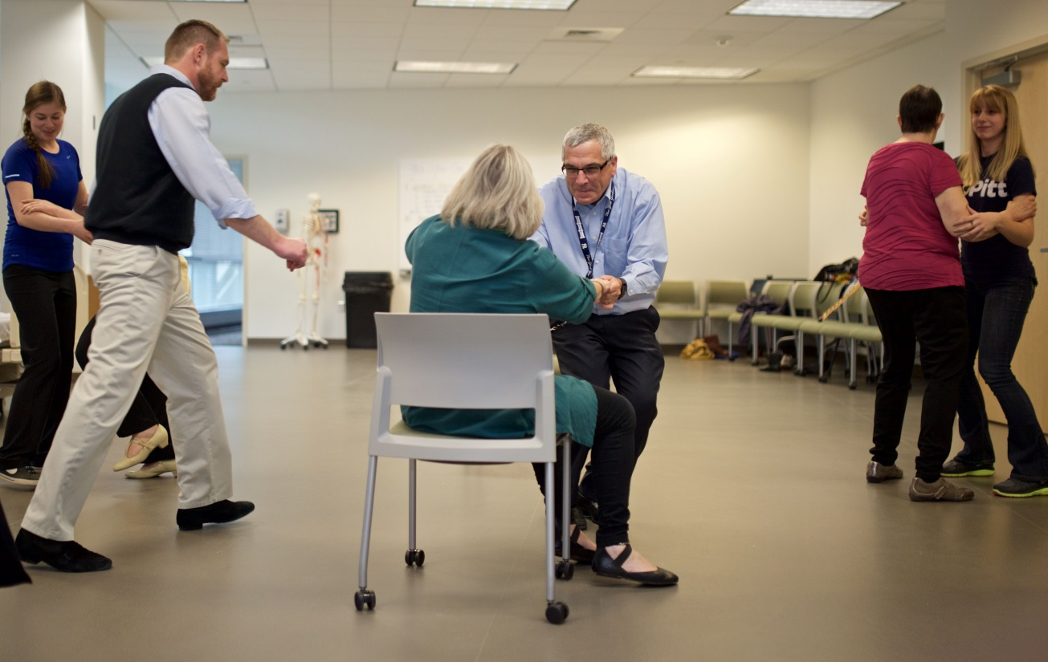
Have a seat if you get tired
- we don’t care
You can even dance in your chair

Slide 9
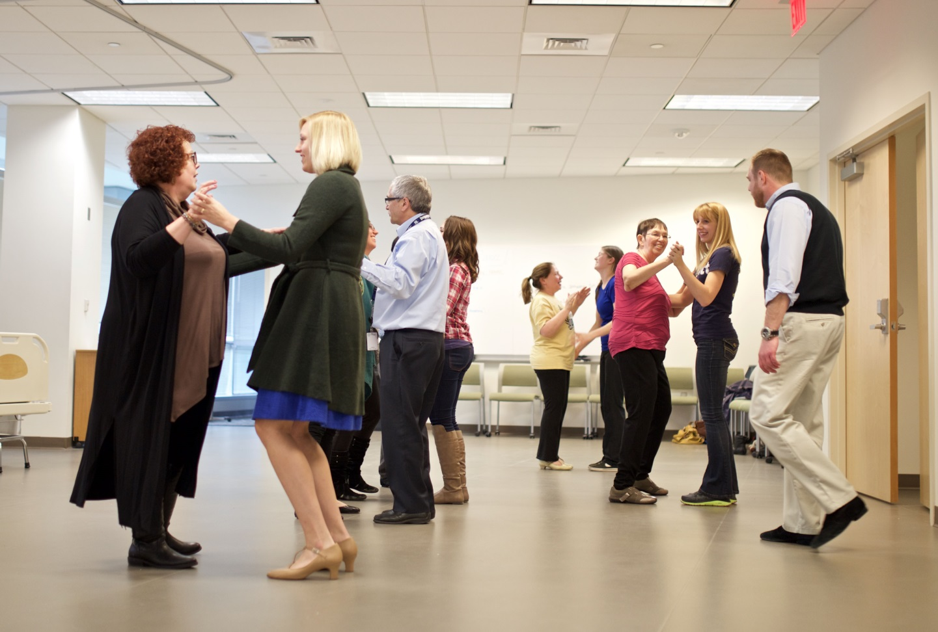
Comments from Participants
“I had such a good time – can’t wait until next week!”
“I haven’t walked backwards since I was diagnosed with MS – I didn’t know I could!”

